Slide 1
Exploring Microsoft .NET 6
By Prashanth Korada
Notes:
Let me start with a confession, I won’t be able to tell you everything new in .NET 6 because its just too much. To give a feeling how much is to cover, you can take a look at the official .net 6 announcement blog post. Just a fun fact , If we print, it will almost fill 70 pages. But here for today I will highlight things that I think really impact me most and could also be interesting for most the .net developers.
The first thing that strikes in our mind is :
Why should I care(support)? Honestly it’s a valid question and every developer should ask when ever there is a shiny new version of framework or tool. However with .net 6 released, end of .net 5 isn’t that far away. While .net 6 is a long term support version providing updates for at least 3 years.
And the second reason is performance. If your application has performance problems or runs in the cloud and you want to save computation time to reduce cost .net 6 is where we can start with.
.Net 6 is introduced on November 8th 2021, surprisingly that happened to be my birthday.

Slide 2
Agenda
Introduction of Microsoft .NET
Microsoft .NET 6
Asp.Net Core
C# 10
Upgrade from .NET 3.1 to .NET 6
Guidelines
Q & A
Notes:
I will give quick introduction to what is Microsoft .NET, how it all origination and giving comparison between .net standard, .net framework and .net core, and then we will start exploring what is .net 6.0 and then we will move on to some of the features that came along with it. Then we will move on to the things that we need to know before we upgrade from .net core solution to .net 6 which is the latest version.

Slide 3
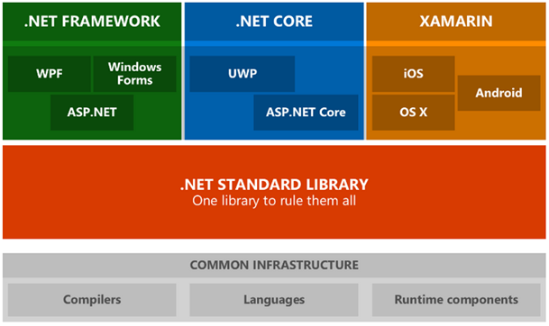
Notes:
To start with I think there are audience from multiple skillset, I would like to give a quick introduction on .NET framework, core , and different terminology so I just want to bring everyone on to the same page. Few people already know about it but just in the interest of common audience I'm going to give quick overview of it. So basically Microsoft has come up with a framework called as dot net which is used to develop windows web app, mobile app, desktop app etc. The only restriction was that it was targeted to the windows platform, it was only supporting the windows operating system, it was not really targeted for different platforms. That’s when Microsoft has started looking at .NET Core, and they basically made it open source and also cross platform implementation of dot net. So it is very difficult to target your particular application for different devices, so then Microsoft started .NET standard which is compatible across multiple devices. So basically it addresses the problem of code sharing for the .NET applications across all platforms.
The .NET Framework is a development platform developed by Microsoft for building apps for web, Windows, Windows Phone, Windows Server, and Microsoft Azure. It consists of the common language runtime (CLR) and the .NET Framework class library, which includes a broad range of functionality and support for many industry standards. It runs primarily on Microsoft Windows. The first version of .NET Framework was released on 13 February 2002.
.NET Core is an open-source, general-purpose development platform maintained by Microsoft and the .NET community on GitHub. It’s cross-platform (supporting Windows, macOS, and Linux) and can be used to build device, cloud, and IoT applications. .NET Core 1.0 was released on 27 June 2016.
The .NET Standard is a formal specification of .NET APIs that are intended to be available on all .NET implementations. The motivation behind the .NET Standard is establishing greater uniformity in the .NET ecosystem. When Microsoft shipped .NET Core 1.0, they also introduced .NET Standard. Code Sharing and reuse.

Slide 4
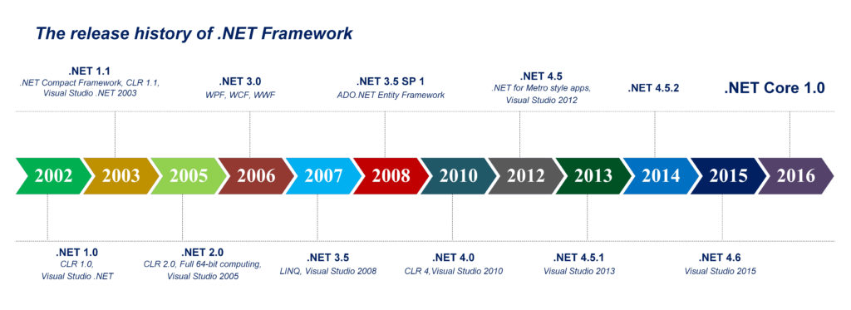
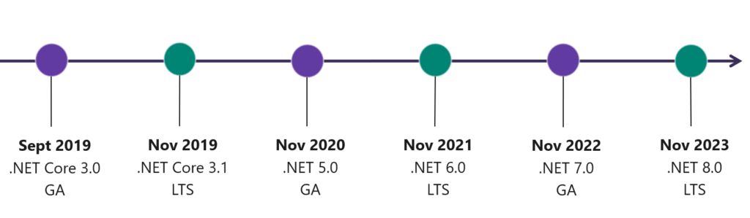
Notes:
Lets move on to some more information on the history of .net. Way back in 2002 that’s when .net initially was started and we used to have wpf,wcf and different other services avialabilty for each requirement. But now with the opening market towards cloud to support multiple operating systems .net came up with .net core in 2016.
And then there were multiple versions of .net core.
Any new applications which are developed now are targeting .net 6, it is considered as the one of the latest versions, also it supports cross platform and they are working on unification process and that is exactly what we wanted to cover in todays session. I hope everyone is on same page now in understanding what is .net and what we are planning to cover.
Dependency Injection and Middleware
Dependency injection is a technique that enables you to replace dependencies in your application with loosely-coupled pluggable components to make your application easier to test and maintain. ASP.NET Core provides support for dependency injection. Actually this support is built into ASP.NET Core. Cross-platform capability
ASP.NET Core is a cross-platform framework for building modern Cloud-based and Internet-based applications. The earlier version of ASP.NET was targeted towards Windows operating system or, the Windows family of operating systems. On the contrary, ASP.NET Core supports multiple platforms, including Windows, Mac, and Linux. So, you can now build and deploy your applications on any of these platforms.
.Net core : is a run time to execute applications build on it
Asp.Net core : is a web framework to build web apps , IoT apps and mobile backends on the top of .net core or .net framework.

Slide 5
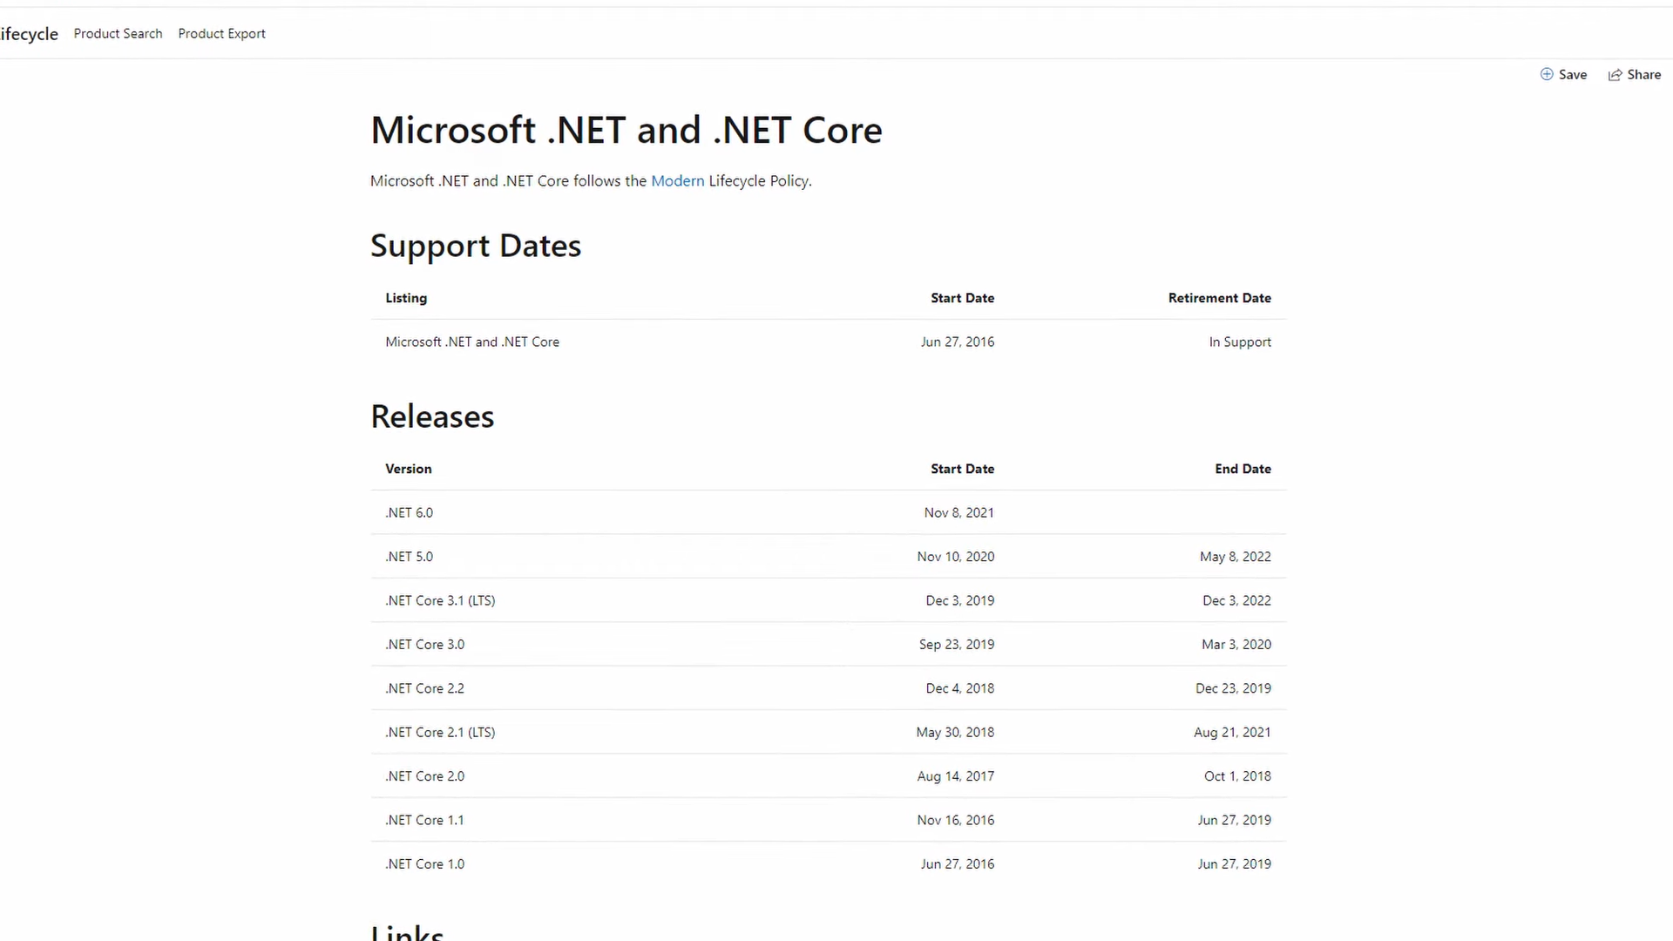

Slide 6
Microsoft .NET 6
Unification of different .NET platforms
Started with .NET 5 and completed in .Net 6
Single BCL and SDK
Hot Reload
Intellicode
C# 10 Features
Asp.Net Core 6
Blazor Extensions
Minimal APIs
Maui
Evolution of Xamarin.Forms
Cross-platform app Development
EF Core
Visual Studio 2022
Notes:
The main target of .net 6 is they wanted unify all the different .net platforms. This unification process is started way back in .net 5 itself but now with .net 6 release they completed the unification process. Now there is no concept of .net framework, libraries or core or something,, we only have Microsoft .net. That’s how the features releases are going to be like 6, 7, 8.
Coming on to some of the features of .net 6, very imp feature which will help us to you know improve the productivity of any developer is hot reload. I will give short demo on it how it works and all.
Lets say I want to debug an API or UI, I want to modify a code in between and want to see that change being reflected dynamically on the UI. So with the hot reload, when you enable that option, you need not to stop the application, make the changes, build it again, run it again and then go back to the page where you wanted to see the result. Now its all dynamic, go ahead make the change and then hot reload will automatically compile it and make sure everything is fine and reflects the change on UI.
Whenever we talk about intellicode, it talks about intellisence. By default visual studio has lot of intelligence features which helps to write your code much faster. With intellicode features which got added with vs 2022 it will make your life easier.
And along with .net 6., we got c# 10 features, I will be covering few features in the coming slides but c# 10 features are something that makes life more cleaner.
Minimal APIs completely reduce the code which you will write.
NET Multi-platform App UI (.NET MAUI) is one of the exciting features of this release. It serves as the cross-platform framework for creating native mobile and desktop apps with C# and XAML. And, by utilizing .NET MAUI, users can develop applications that can run on Android, iOS, iPadOS, macOS, and windows.
Blazor is a framework for building interactive client-side web UI with .NET:Create rich interactive UIs using C# instead of JavaScript.Share server-side and client-side app logic written in .NET.Render the UI as HTML and CSS for wide browser support, including mobile browsers.Integrate with modern hosting platforms, such as Docker

Slide 7
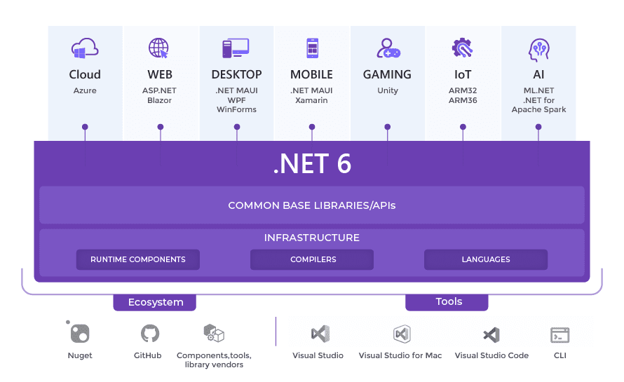
Notes:
Understanding Different platforms
.Net framework →windows only , Xamarin → ios and android , .net core → cross platform =➔ Everything has its own Base Class Library
To solve above problem , .Net Standard is started which would be compatible in all platforms
In .Net 6 all platforms are unified and it is common platform used to build any type of application

Slide 8
C# 10 Features
Global using Statements
File Scoped Namespaces
DateOnly
TimeOnly
Const Interpolated strings
Notes:
Here are some of the common features released with C# 10. Previously we used import lot of libraries in a single cs file, but very commonly we use System namespace in every file that we write code. So there lot of redundancy here and also same namespace is being imported in almost all the files. So then Microsoft came up with a global using statements with c# 10, where you will create your own separated isolated file and then we gonna list down all the global using statements. This way we can avoid redundancy and when you refer for one time, that all applicable for the complete application.
File Scoped Namespaces : everything a class or namespace is enclosed in a flower braces, now to remove that redundancy file scoped namespaces introduced just similar to using statements. By removing the unnecessary flower braces the code looks much cleaner
Next interesting feature is date only time only, as using current date/time is commonly needed in most of the code base and with the current coding style to get a specific time/date we have write couple of statements and retrieve information from there.
We cannot do constant interpolation in C# 9, now these constants are reusable in other constants as well.
There are other features as well like serialization, json path and all but just in the interest of time I’m just restricting it to some of the features I found interesting. Lets move on to upgrade

Slide 9
Upgrading Existing ASP.NET Core Projects
Update the target framework in the project file
Update package references (Can use Nuget package Manager)
Delete bin and obj folders
Minimal hosting model: The minimal hosting model unifies Startup.cs and Program.cs into a single Program.cs file.
For apps using Docker, update your Dockerfile FROM statements and scripts. Use a base image that includes the ASP.NET Core 6.0 runtime
Notes:
So, this is the core of it, I pulled one of our existing application which is in 3.1 version of .net core and went through the process of migrating to .net 6.
Here are some steps to be followed, I will give a live demo of before and after solution and just show steps that I followed. But in short these are some of the steps
Edit or right click toi change the targeted framework to .net 6.0
Once upgrading the packages . Each solution may different issues, issues like sometimes the packages are not available you need to specifically add those 6.0 related package and do an upgrade. So it takes some time but its not so complex where you gonna end up in completely re writing the whole application. Atleast to the extent of the upgrade I have done it was like we already have a compatible package and I was able to update in smoother way
Once the packages are updated , as when we keep on cleaning up the solution , bin, objs will get cleaned up and after rebuilding those gets updated with the latest versions of packages.
I think all of our application have unit test cases and we need make sure those projects are also mapped to the target framework. Also there could be a potential chances of errors when cleaning up , some of the class libraries might also needs to be updated as well. When the unit test perspective the other challenges that I have seen is the client host tool is missing, then I did some investigation on it and found that test cases are missing a package called Microsoft.NET.Test.Sdk , by adding it to the application it helped in pulling up client host. After that everything was passing.
So yeah, every application may have a different problem, but the basic fundamental steps are the one which are listed here. Just follow these steps, I hope everything works fine, but if you get any different issue specific to that project we can take a deeper look into that, if the project is compatible to 6.0 , like alternative in that and all.

Slide 10
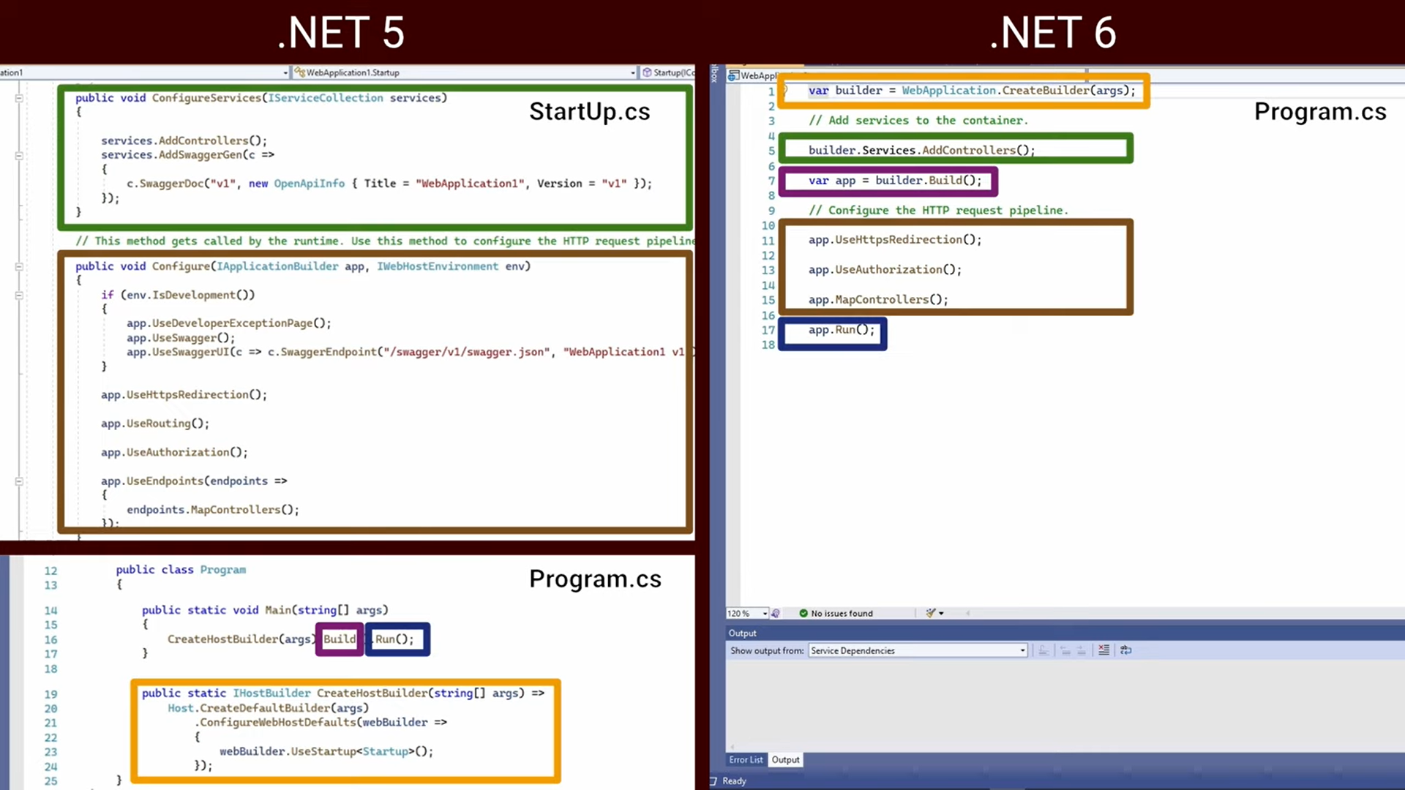

Slide 11
Q&A
Notes:
I hope we could get something out of this session, and let me know if anyone has questions or you think you want me to explore more or you want to share some information. If not thank you all for your time.

